Slide 1
DIGITAL SIGNAL PROCESSING ALGORITHMS FOR ACTIVE CONTROL OF INDIVIDUAL ACOUSTIC ZONES
Presented by:
ANATOLIJ BORRONI

Slide 2
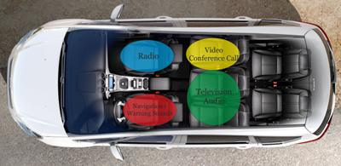
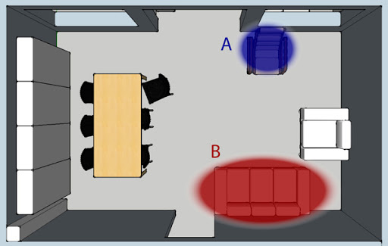
Individual sound zones
Target: create individual sound regions in the shared environment where people perceive different audio contents

Slide 3
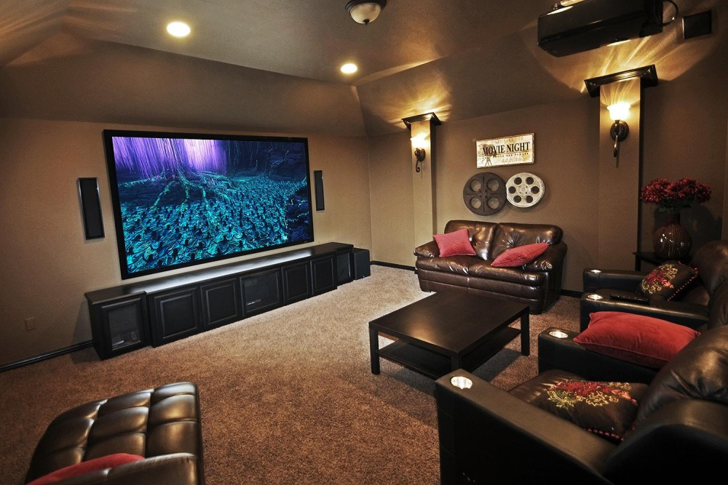
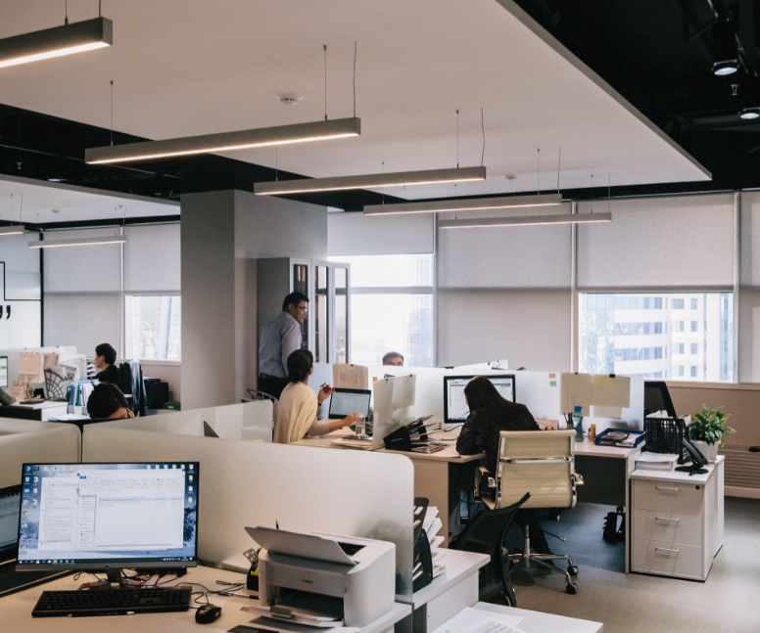
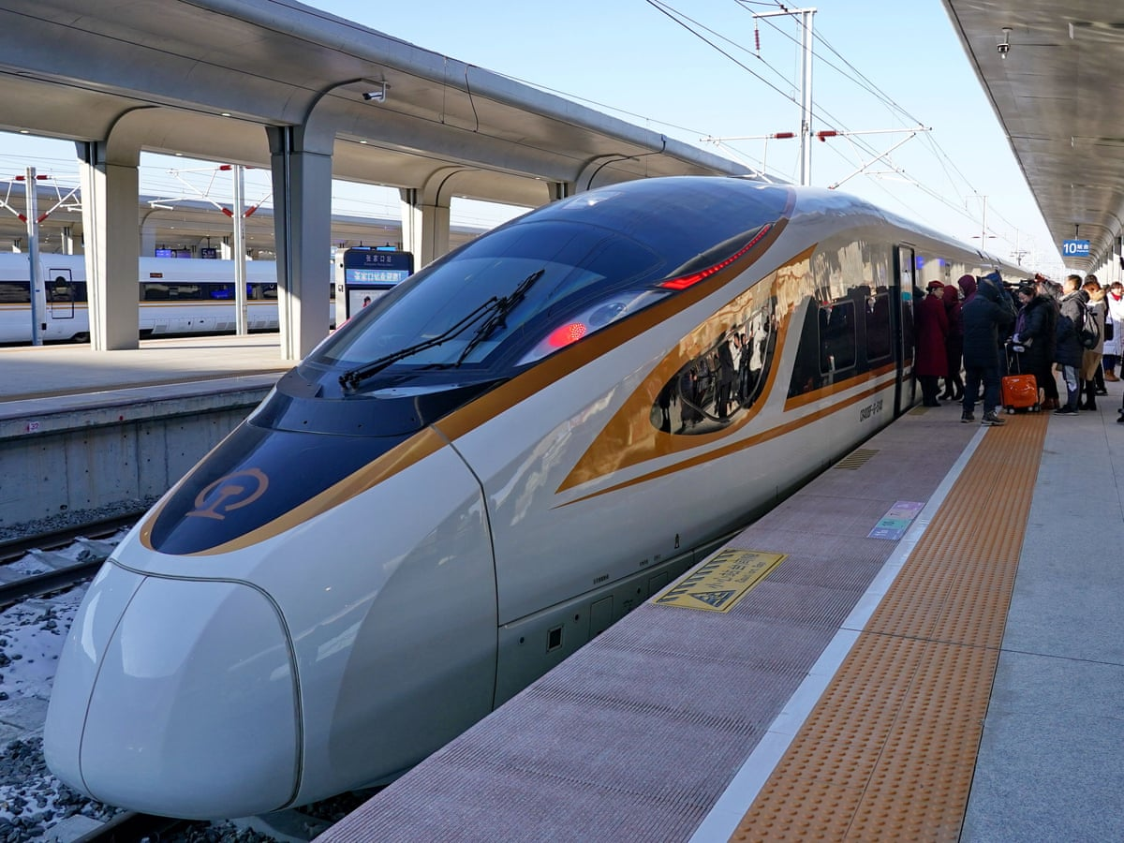
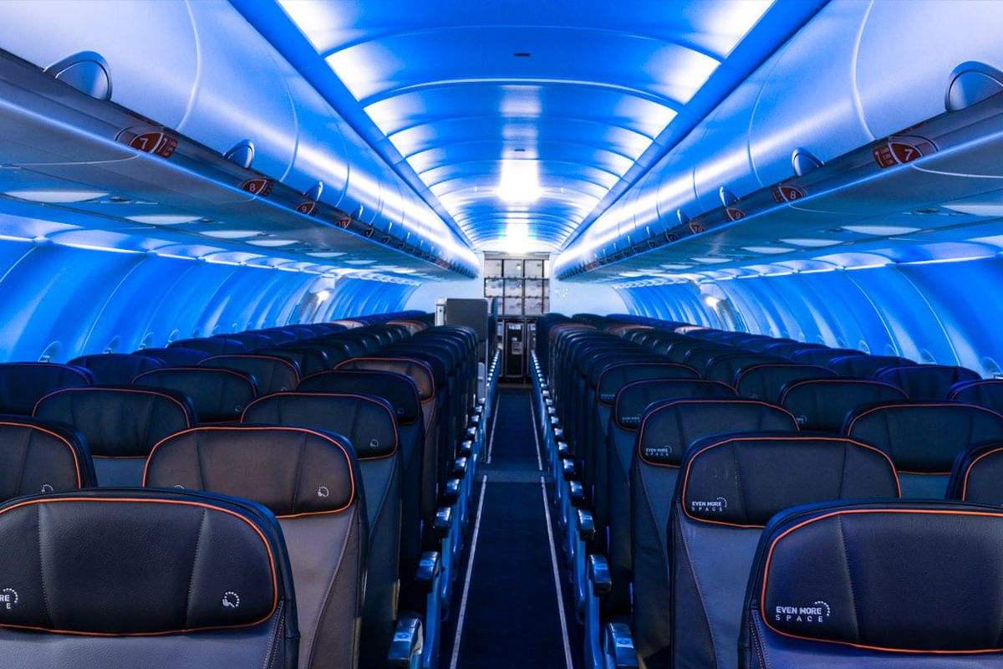
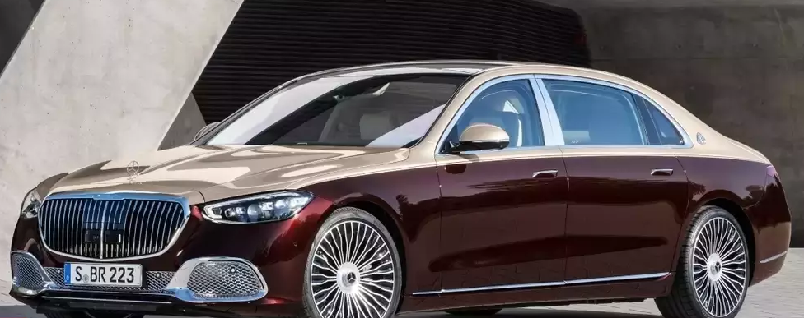
Applications
Personal spaces and vehicles
Public spaces and vehicles

Slide 4
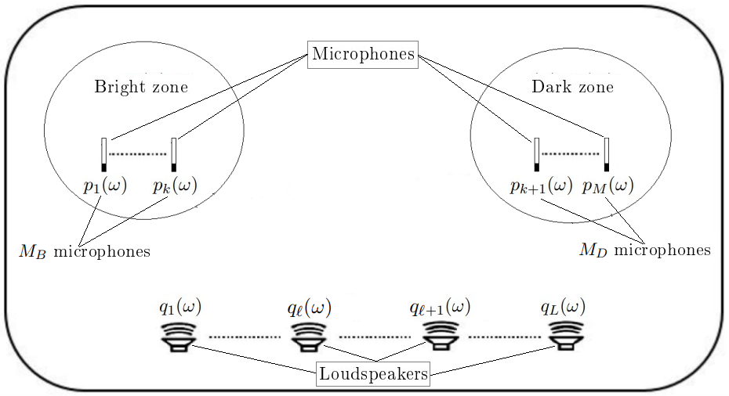
Model

Slide 5
Superposition Principle
$$h_{1,1}(ω)$$
$$h_{1,l}(ω)$$
+
$$p_{1}(ω)$$
Audio signal
$$q_{1}(ω)$$
$$h_{1,L}(ω)$$
Microphone acoustic pressure
$$h_{k,1}(ω)$$
$$h_{k,l}(ω)$$
+
$$p_{k}(ω)$$
$$s(ω)$$
$$q_{l}(ω)$$
$$h_{k,L}(ω)$$
$$h_{M,1}(ω)$$
$$q_{L}(ω)$$
Loudspeaker-microphone FRs
$$h_{M,l}(ω)$$
+
$$p_{M}(ω)$$
Loudspeaker pre-filters
$$h_{M,L}(ω)$$

Slide 6
How?
1° step: measurement of the impulse responses between each loudspeaker and each microphone
2° step: calculation of the optimal loudspeaker pre-filters by the chosen algorithm (Pressure Matching, Acoustic Contrast Control, etc.)

Slide 7
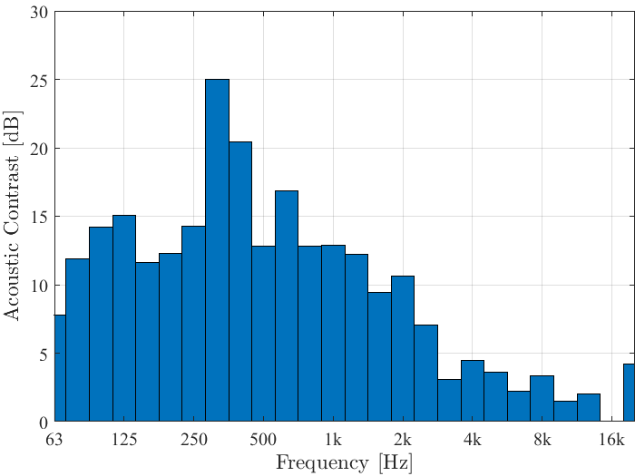
Performance example
Acoustic contrast: difference between the sound pressure levels (dB) of 2 different regions

Slide 8
Future works
Analysis of the channel matrix eigenvalues for performance prediction and loudspeaker calibration
Performance comparison between system with more microphones than loudspeakers and vice-versa
Derivation and implementation of perceptual metrics for performance evaluation
Derivation and implementation of algorithms based on perceptual metrics

